Slide 1

Nhân bản – Phụng sự – Khai phóng
FACULTY OF COMPUTER ENGINEERING AND ELECTRONICS
GRADUATION PROJECT
DESIGN AND DEVELOPMENT OF A REAL-TIME DISPLAY INSTRUMENT CLUSTER INTEGRATED WITH AI FOR ADVANCED DRIVER ASSISTANCE SYSTEM
Student Name: Tran Van Quoc Dat
Student ID: 21CE077
Supervisor: MSc. Nguyen Thi Huyen Trang
Da Nang, January, 2026

Slide 2

OUTLINE
Acknowledgment
Overview
Project Goals
Theories
Methodology
Results
Findings
Conclusions
2

Slide 3
Acknowledgment
I would like to express my deepest gratitude to:
The Board of Directors and Faculty of VKU University for providing invaluable knowledge and support throughout my studies.
My supervisor, Professor Nguyen Thi Huyen Trang, for her dedicated guidance, professional advice, and unwavering encouragement.
My family and friends for being my motivation and support in this project.
The thesis evaluation committee for their time and valuable feedback that helped to perfect this thesis.
3

Slide 4
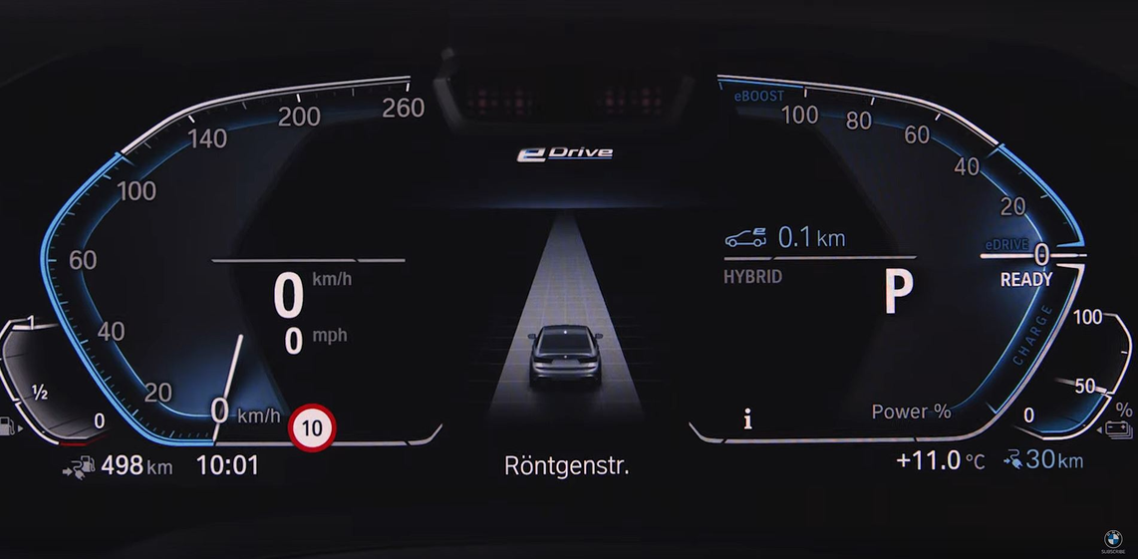
Overview
Context: The automotive industry is entering a technological revolution (EV, Autonomous, IoT).
Challenge: The old mechanical instrument panel no longer meets the complex information display needs of modern vehicles.
Solution & Trend: Digitalization to Digital Instrument Cluster.
Increased visual appeal.
Diversified displayed information.
Enhanced modern driving experience.
4

Slide 5
Project Goals
Distributed hardware with 4 stable nodes.
Reliable communication via CAN Bus network.
Integrated AI for real-time traffic sign recognition.
Smooth on-screen interface.
5

Slide 6
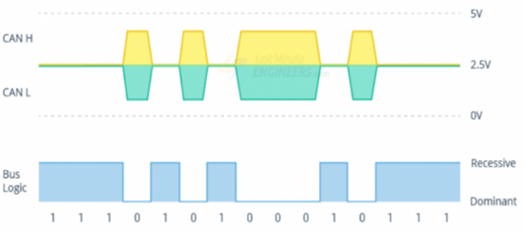
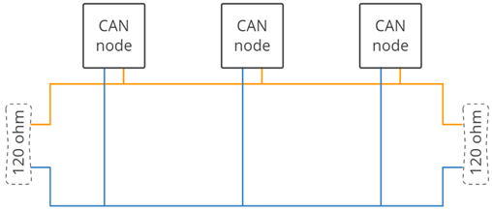
THEORIES (1/3)
Fundamental theoretical basis
Advanced Driver Assistance Systems:
A collection of active safety technologies that help minimize accident risks and assist the driver.
In this project: Focus on collision warning, engine control, and traffic sign recognition.
Controller Area Network Protocol:
Principle: Uses differential signals on two CAN_H and CAN_L wires, providing extremely high interference resistance in the automotive environment.
Arbitration Mechanism: The network does not have a fixed Master/Slave. In case of conflict, the right to transmit belongs to the packet with the smaller ID.
6

Slide 7
THEORIES (2/3)
Technology & Algorithms
MobileNetV2 Model:
Combines MobileNetV2 for traffic sign recognition.
Applies a Hybrid Approach: Pre-filters HSV colors to define ROI, reducing AI load.
TFLite Quantization:
Quantizes the model from Float32 to Int8.
Optimizes inference speed on Raspberry Pi ARM CPUs.
Qt/QML & PyQt5:
Separate architecture: Backend – Frontend.
Signal & Slot mechanism: Asynchronous interface updates, preventing UI hangs.
FreeRTOS operating system:
Applicable to Gateway Node.
Multitasking management: Prioritization for CAN receiving tasks and UART sending tasks.
7

Slide 8
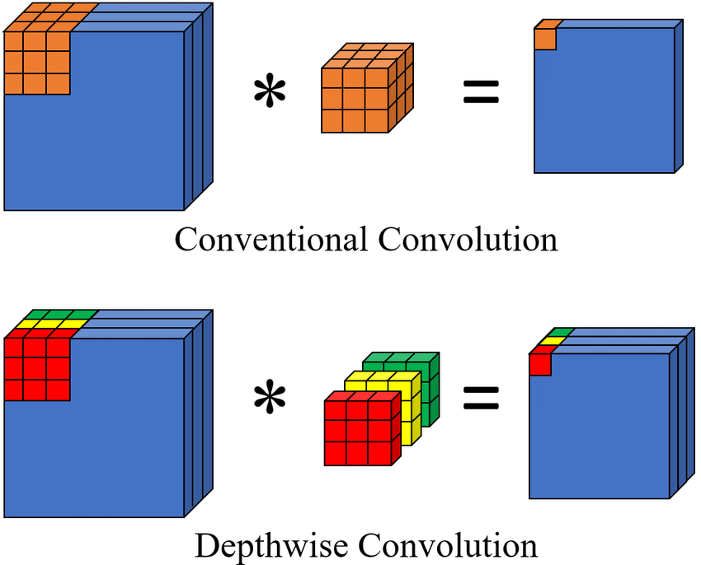
THEORIES (2/3)
MobileNetV2 + TensorFlow Lite for Embedded Devices
Why
Lightweight CNN architecture, optimized for low-resource devices
Uses Depthwise Separable Convolution
Good balance between accuracy, speed, and memory
How
Convert the model to TFLite + Quantization
Reduced model size
Result
Stable traffic sign recognition
FPS meets system requirements
12

Slide 9
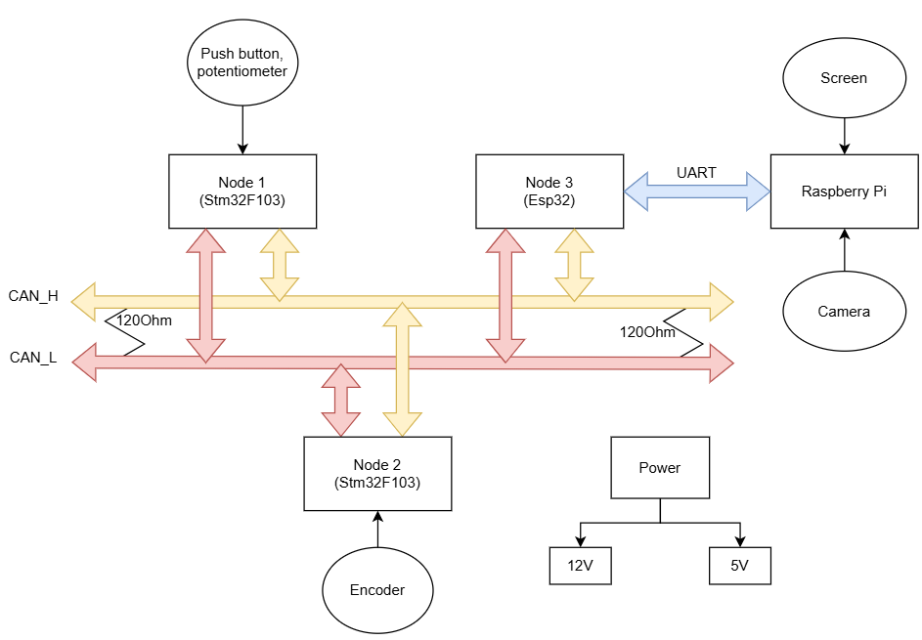
METHODOLOGY (1/6)
System Analysis & Architecture
System Requirements Analysis:
Functional: Collecting steering signals, controlling the motor, AI traffic sign recognition, displaying the interface.
Non-functional: Real-time operation, reliable communication in noisy environments.
Distributed System Architecture:
Connection Model: 4 independent nodes communicating via CAN Bus and UART.
Node 1 - Body Control: Collects input signals.
Node 2 - Motor Control: Controls actuators and provides speed feedback.
Node 3 - Gateway: Bridges CAN and UART data conversion.
Node 4 - Central Unit: Handles heavy tasks and user interface.
8

Slide 10
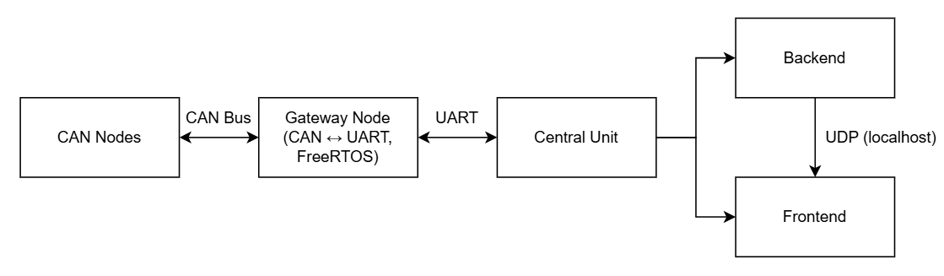
METHODOLOGY (2/6)
Algorithm Design & Data Flow
Data Pipeline:
CAN Bus: 50ms cycle.
Gateway: Converts between CAN and UART.
Central Unit: Receives data stream for display.
Gateway Node (Multitasking):
TaskSerial: Sends display data.
Synchronization: Uses Mutex to lock shared memory.
Central Unit:
Mechanism: Separates the Backend and Frontend.
IPC Communication: Uses UDP Localhost.
14

Slide 11
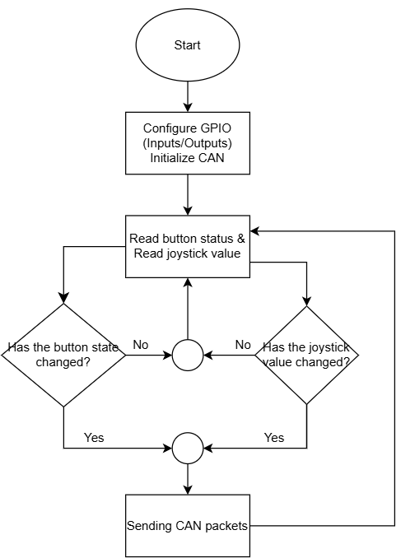
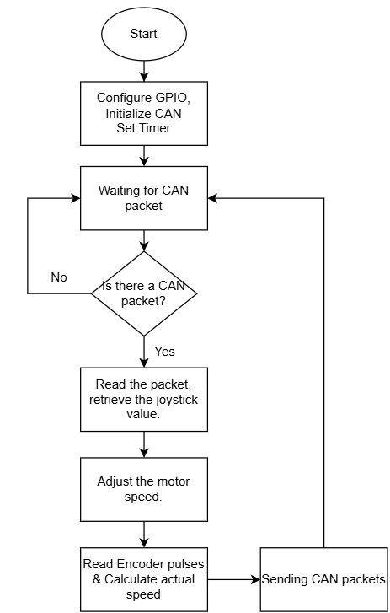
METHODOLOGY (3/6)
Algorithm Flowcharts
Algorithm flowchart for Body Control Node
Motor Control Node algorithm flowchart
9

Slide 12
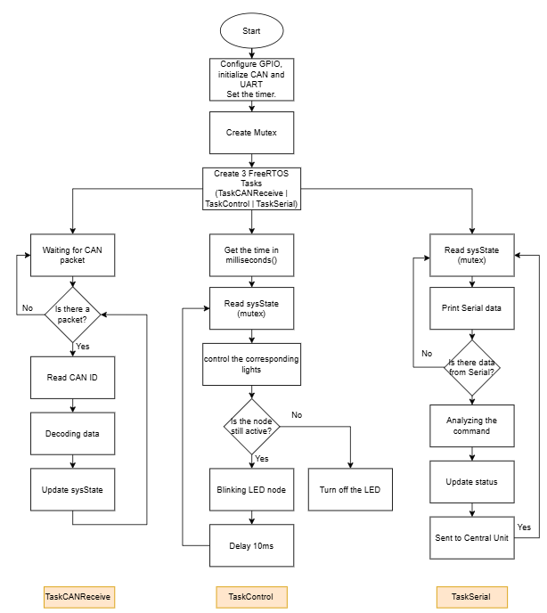
METHODOLOGY (4/6)
Algorithm Flowcharts
The system runs on FreeRTOS, handling parallel multitasking.
Central data is managed using sysState + mutex.
Communication includes CAN (data reception) and UART (command transmission).
Logic is divided into three main functions:
Receiving & processing data
Controlling devices
Communicating with the Central Unit
10

Slide 13
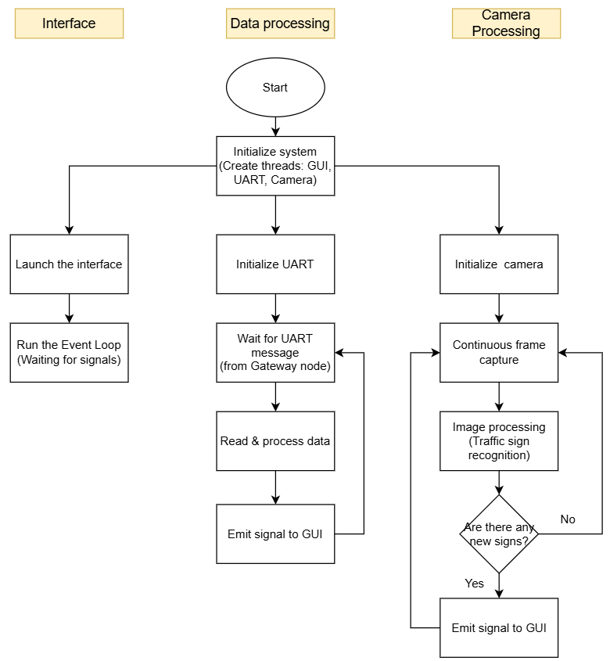
METHODOLOGY (5/6)
Algorithm Flowcharts
The Central Unit is the central processing node of the system.
It operates on a multi-threaded model.
It consists of 3 main functional blocks:
Interface: displaying and interacting with the user.
Data Processing: receiving and processing data from the Gateway via UART.
Camera Processing: recognizing traffic signs.
The processing results are synchronized and displayed on the GUI.
11

Slide 14
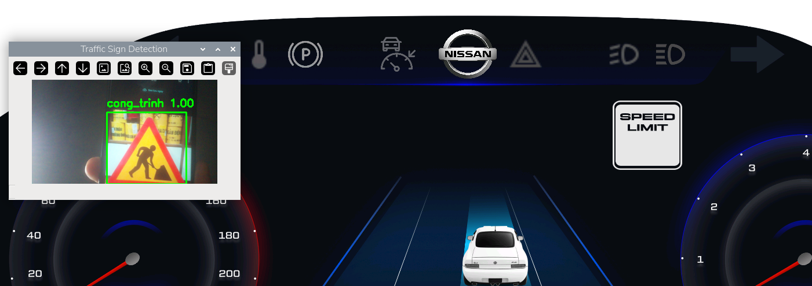
METHODOLOGY (6/6)
Image processing and AI workflows
Pre-processing: HSV color conversion Red/green color filtering ROI cropping.
Inference: Incorporating ROI into the TFLite model for classification.
Stable Logic: Consecutive Frames Validation algorithm - Only displays results when identical recognition occurs in 4 consecutive frames
13

Slide 15
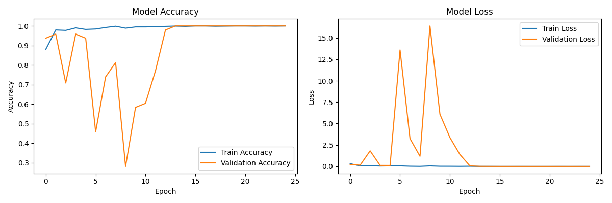
RESULTS
Training Performance Metrics: Accuracy and Loss over Epochs
15

Slide 16
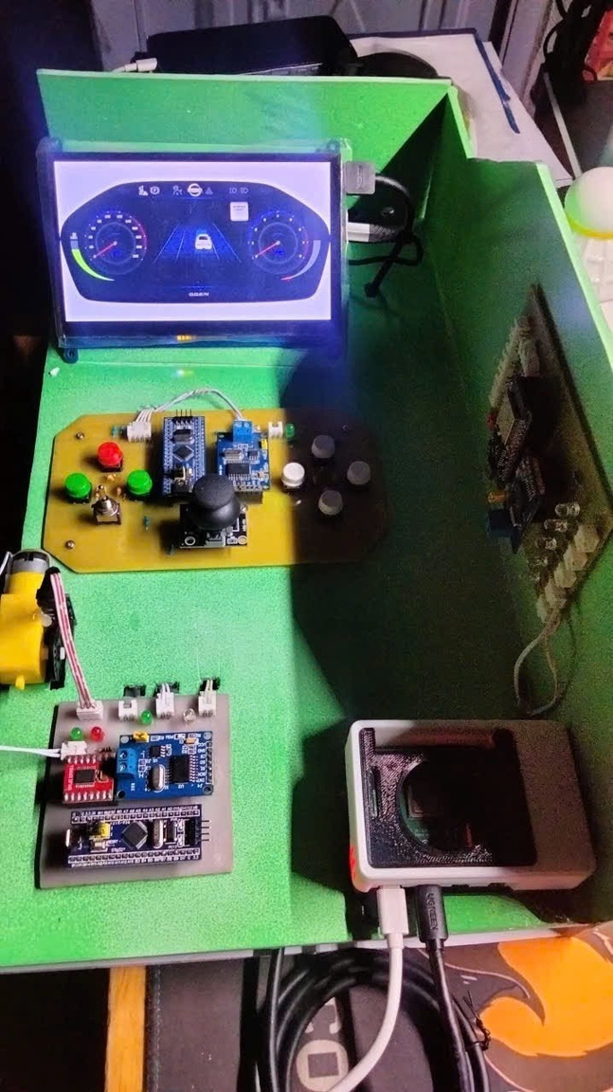
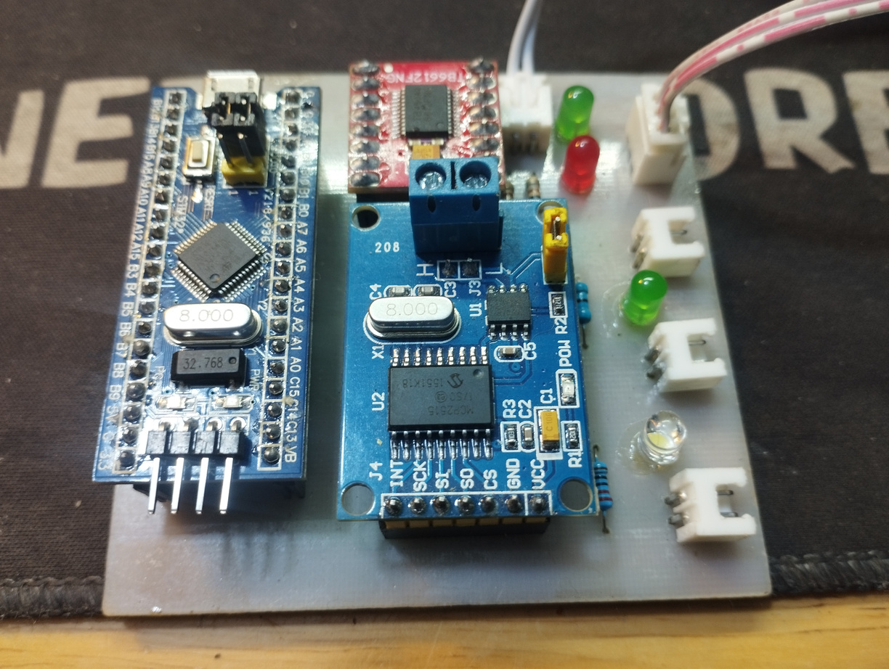
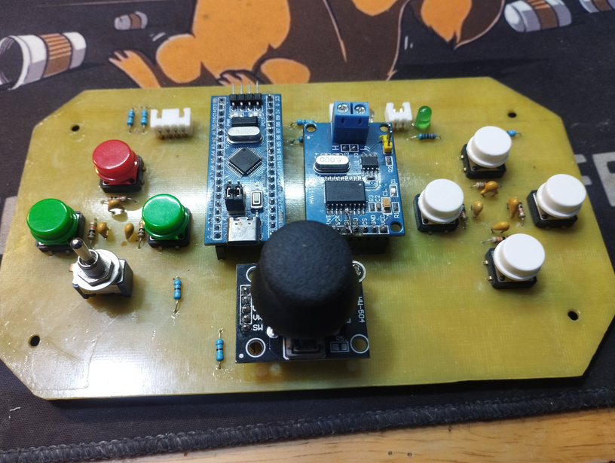
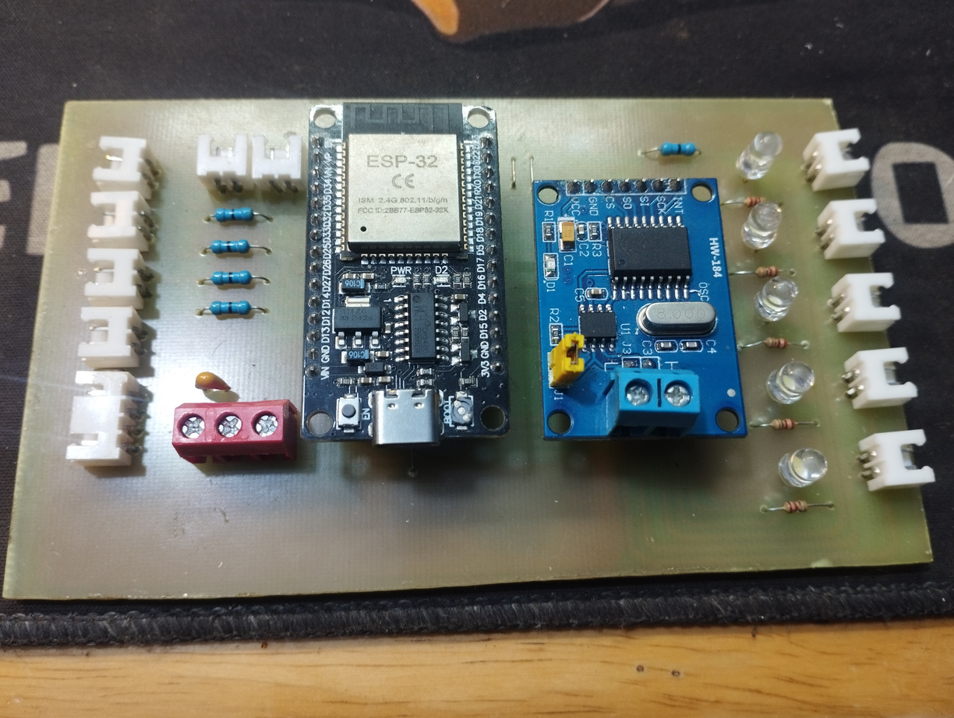
RESULTS
16

Slide 17
FINDINGS
System Performance:
AI Processing Speed: 25-30 FPS.
System-wide Latency: ~100ms.
Stability:
CAN Network: Packet Error Rate < 1%.
System operates continuously for > 1 hour without crashing.
Compared to Objectives: 100% of the set functions (Hardware, Communication, AI, Display) have been completed.
17

Slide 18
CONCLUSIONS
Summary:
Successfully built an integrated embedded system.
Effectively applied technologies: Qt/QML, TFLite, FreeRTOS.
Limitations: Camera performance is limited in backlit conditions; Pi cooling needs improvement.
Future Development:
Upgrade to CAN-FD standard.
Expand the traffic sign dataset (traffic lights, lanes).
18

Slide 19

Nhân bản – Phụng sự – Khai phóng
THANK YOU FOR LISTENING!
Q&A

